Slide 1

Fraud Detection in Online Payment Method
Group No: 10
Group Members:
Yash Shah (2021004500210160)
Nandini Bhavsar (2021004500210016)

Slide 2
Introduction
Fraud detection in online payments helps prevent scams and unauthorized transactions. It uses security measures like AI, machine learning, and real-time monitoring to spot suspicious activities.
Common frauds include stolen card details, fake identities, and phishing attacks. Banks and businesses use fraud detection to protect customers and reduce financial losses.
Alerts and verification steps, like OTPs, add extra security. As online payments grow, detecting fraud becomes more important to ensure safe transactions.

Slide 3
Problem Definition
Fraud detection in online payment methods involves identifying suspicious activities or unauthorized transactions to prevent financial losses. The goal is to analyze patterns in user behavior and transaction data to detect anomalies that may indicate fraud. Data science techniques like machine learning are used to classify transactions as normal or fraudulent. It ensures secure online payments and protects user accounts.

Slide 4
Source Of Dataset
Fraud detection in online payment method(Kaggle)
Link: https://www.kaggle.com/datasets/jainilcoder/online-payment-fraud-detection

Slide 5
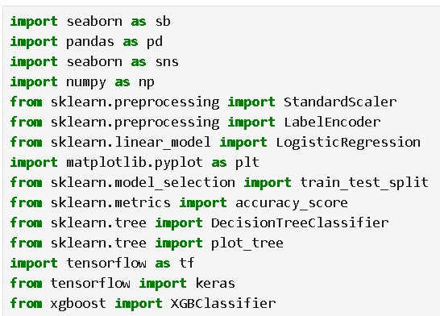
Import Libraries

Slide 6
Read Data

Slide 7
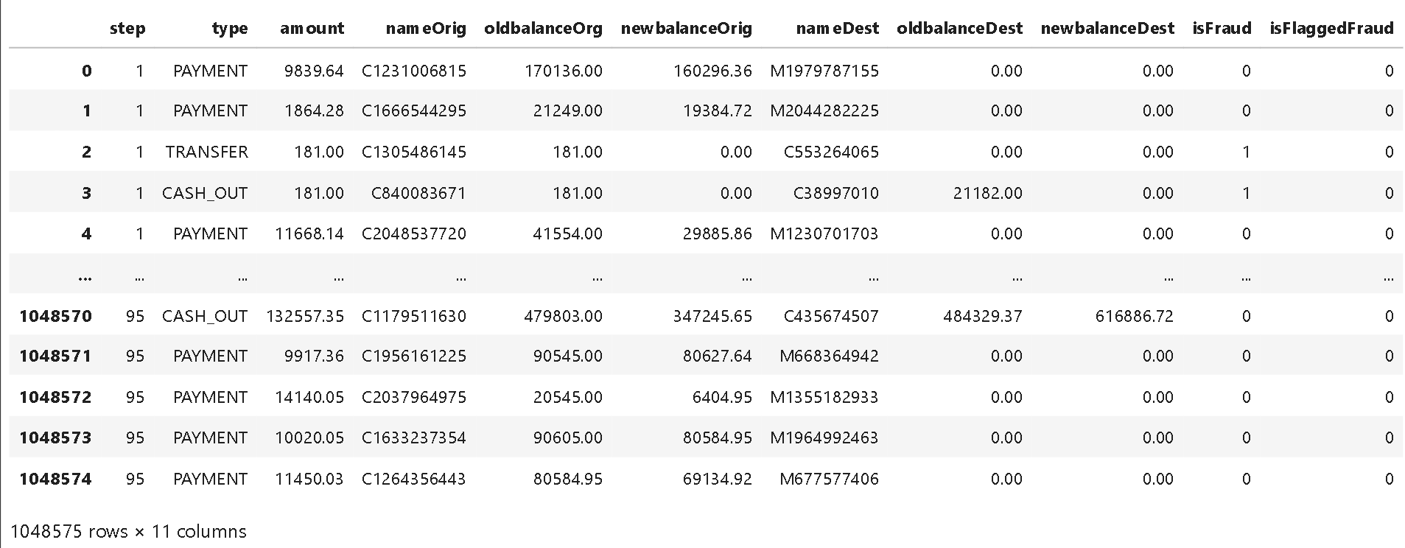
Read Data

Slide 8
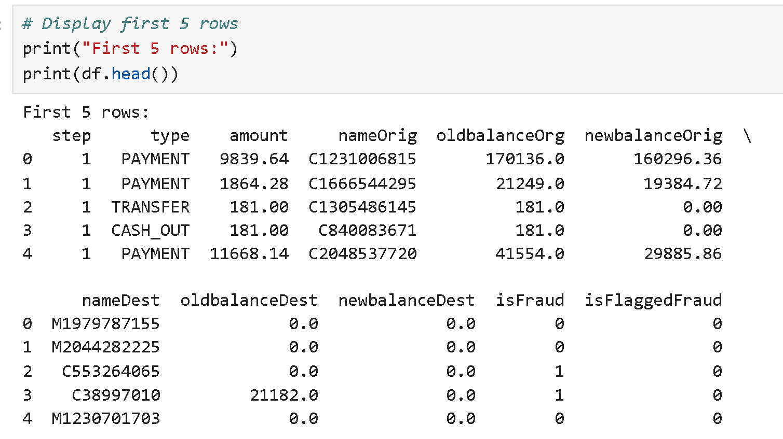
Read Data

Slide 9
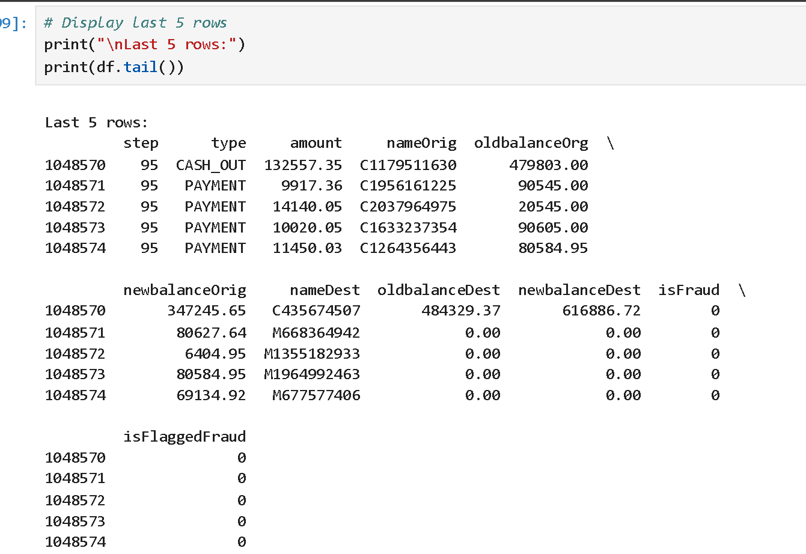
Read Data

Slide 10
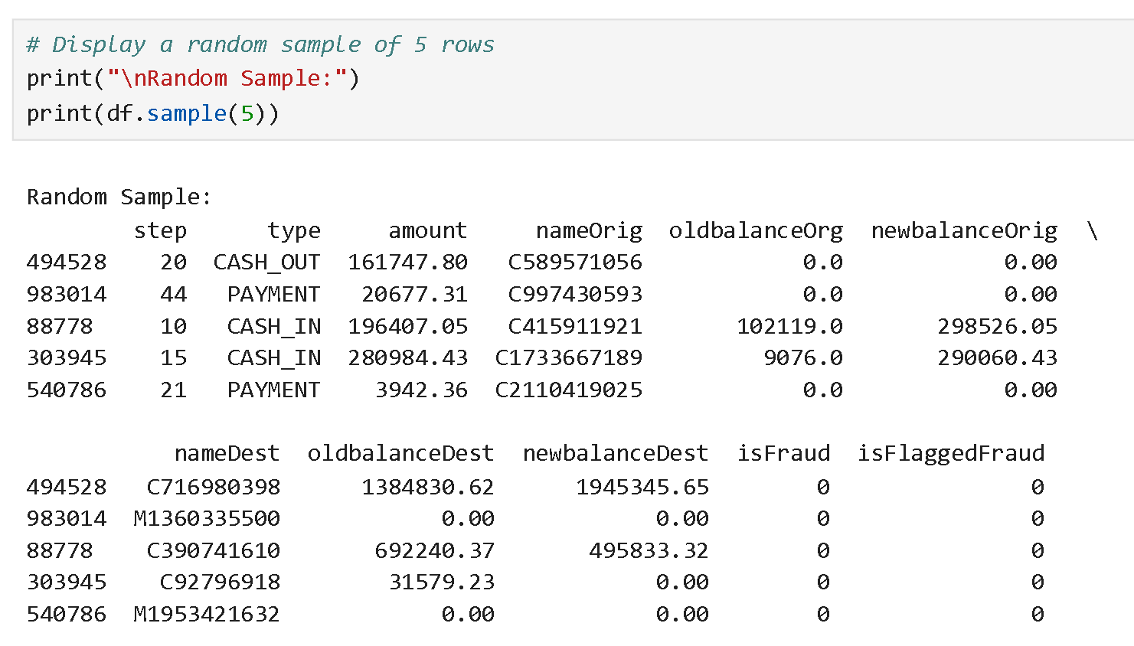
Read Data

Slide 11
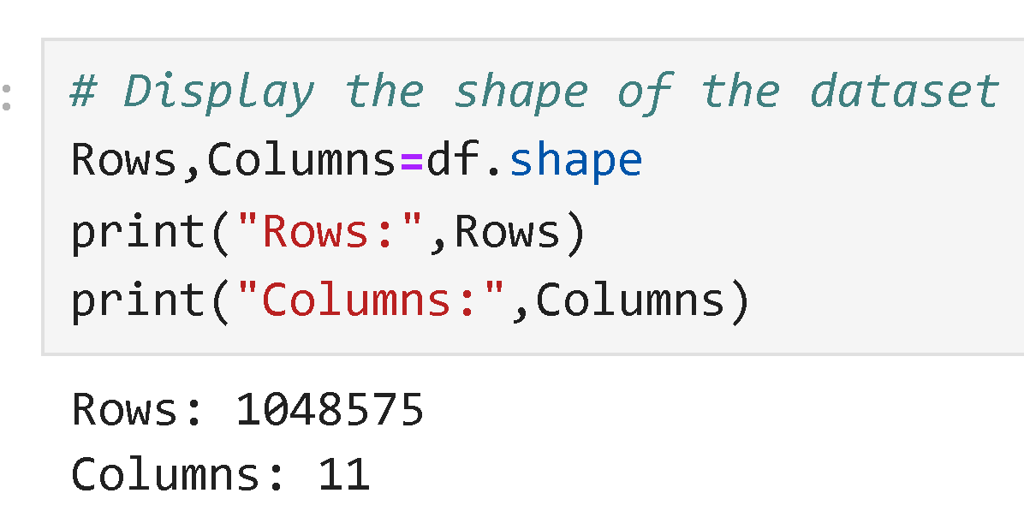
Volume
Here we can see the number of columns and number of rows

Slide 12
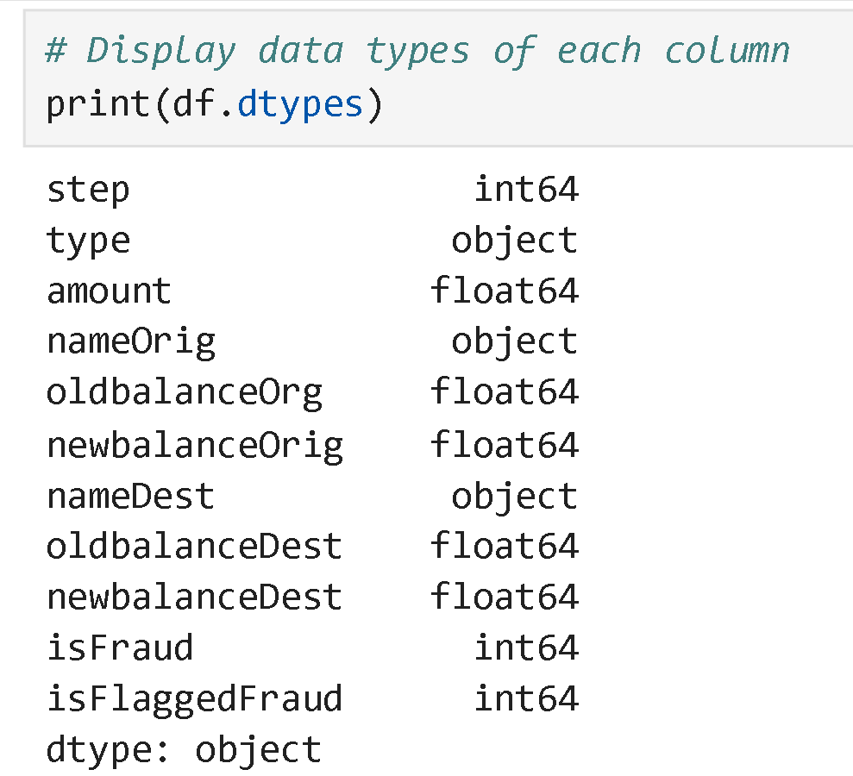
Data Types
Here we can see the data types of columns

Slide 13
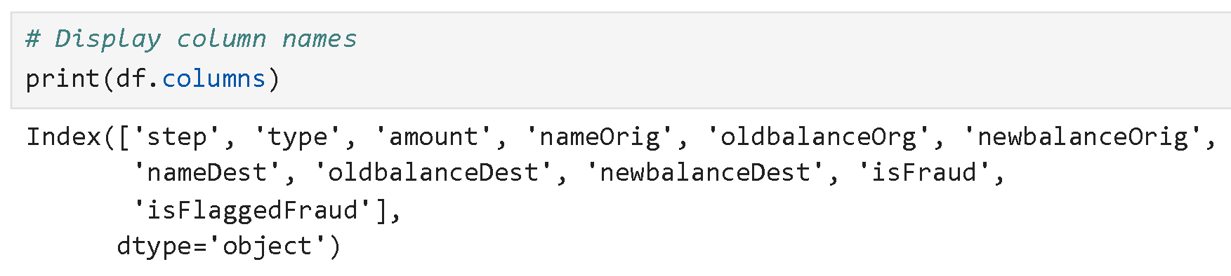
Columns

Slide 14
Column Description
Column Name | Description
step | Represents the unit of time (e.g., hours, days, or transaction sequence) at which the transaction was made.
type | The type of financial transaction, such as CASH-IN, CASH-OUT, DEBIT, PAYMENT, or TRANSFER.
amount | The transaction amount in monetary units.
nameorigin | The unique identifier (or masked account ID) of the sender (originating account).
oldbalanceorg | The balance of the sender's account before the transaction was made.
newbalanceorg | The balance of the sender's account after the transaction was made.

Slide 15
Column Description
namedest | The unique identifier (or masked account ID) of the recipient (destination account).
oldbalancedest | The balance of the recipient’s account before the transaction was made.
newbalancedest | The balance of the recipient’s account after the transaction was made.
isfraud | A binary column (0 = Not Fraud, 1 = Fraud) indicating whether the transaction was fraudulent.
isflaggedfraud | A binary column (0 = Not Flagged, 1 = Flagged) indicating if the transaction was flagged as fraudulent by the system. This is different from actual fraud detection.

Slide 16
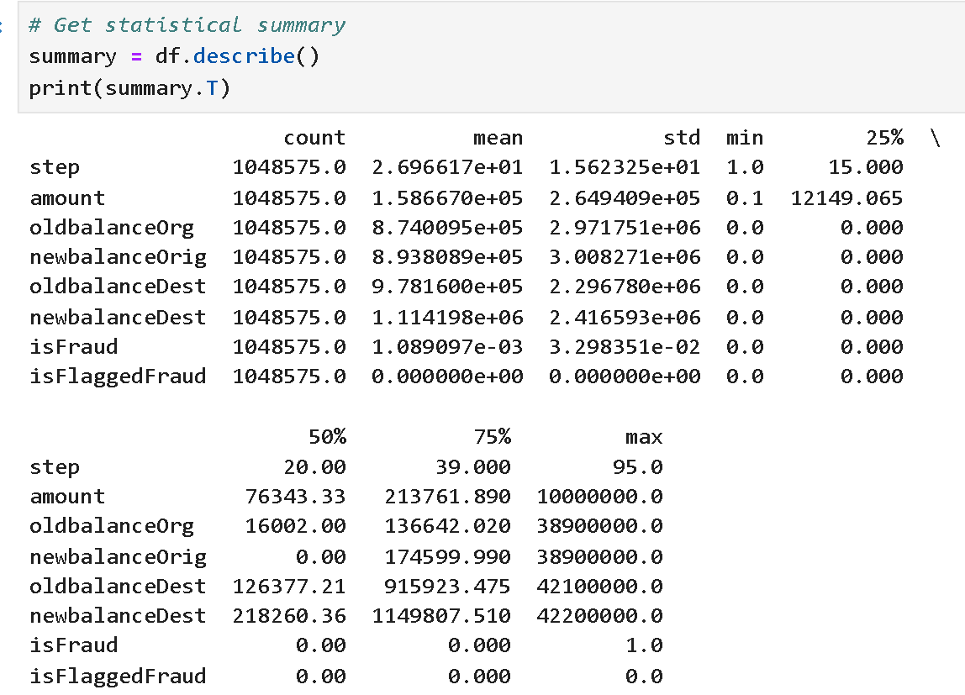
Statistical Summary

Slide 17
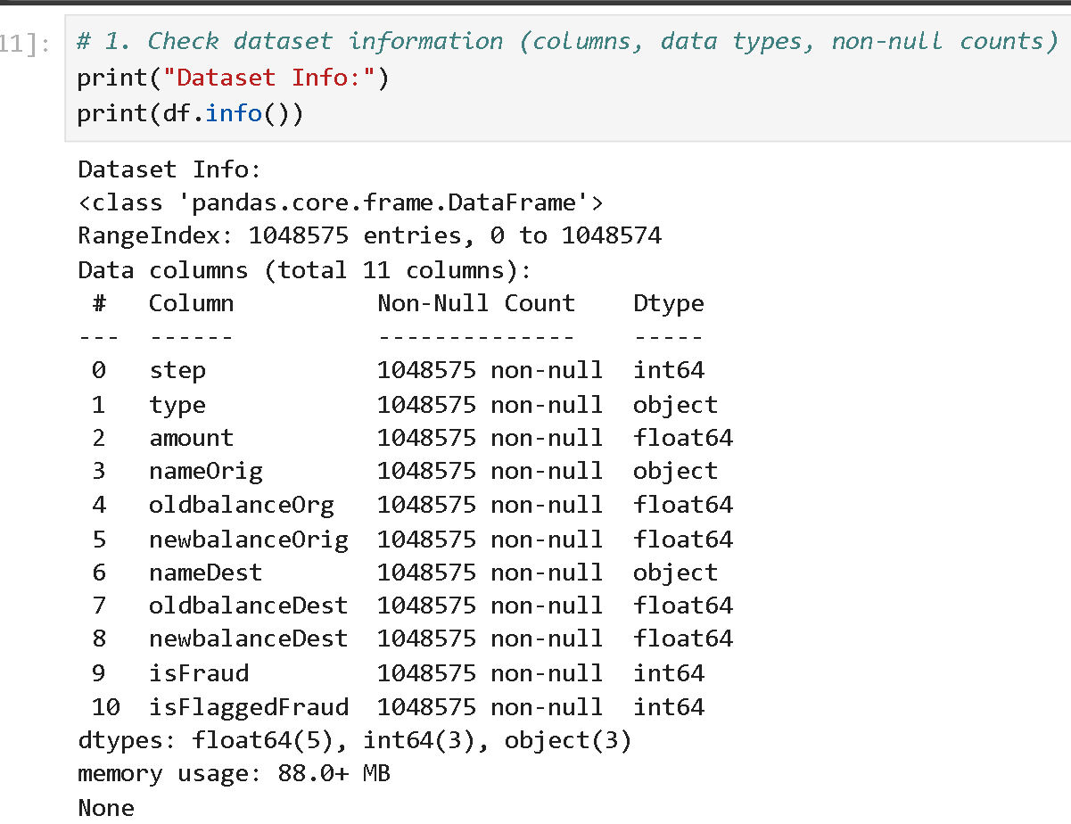
Data Cleaning

Slide 18
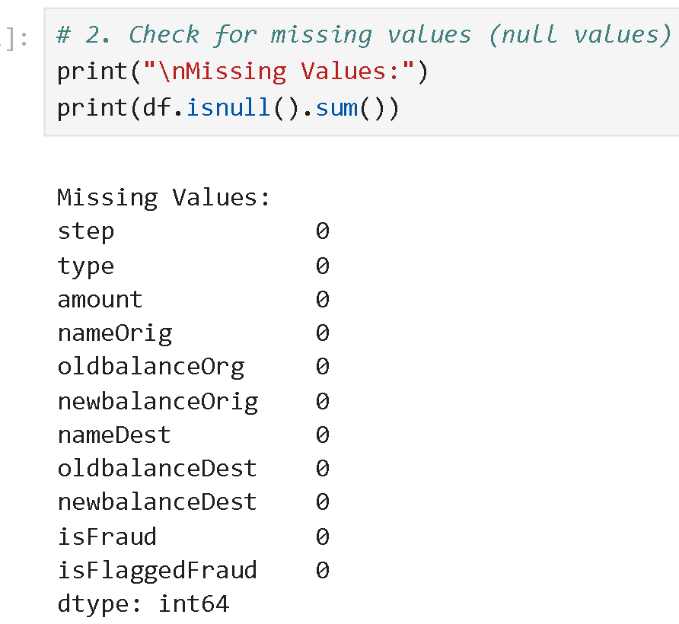
Data Cleaning
Since there are no null values, we did not apply any operation

Slide 19
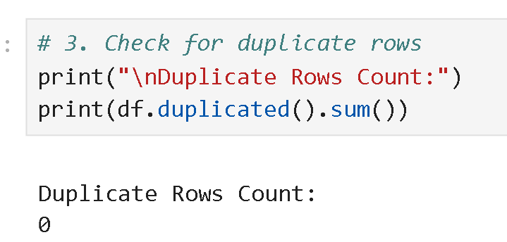
Data Cleaning
Since there are no duplicated values, we did not apply any operation

Slide 20
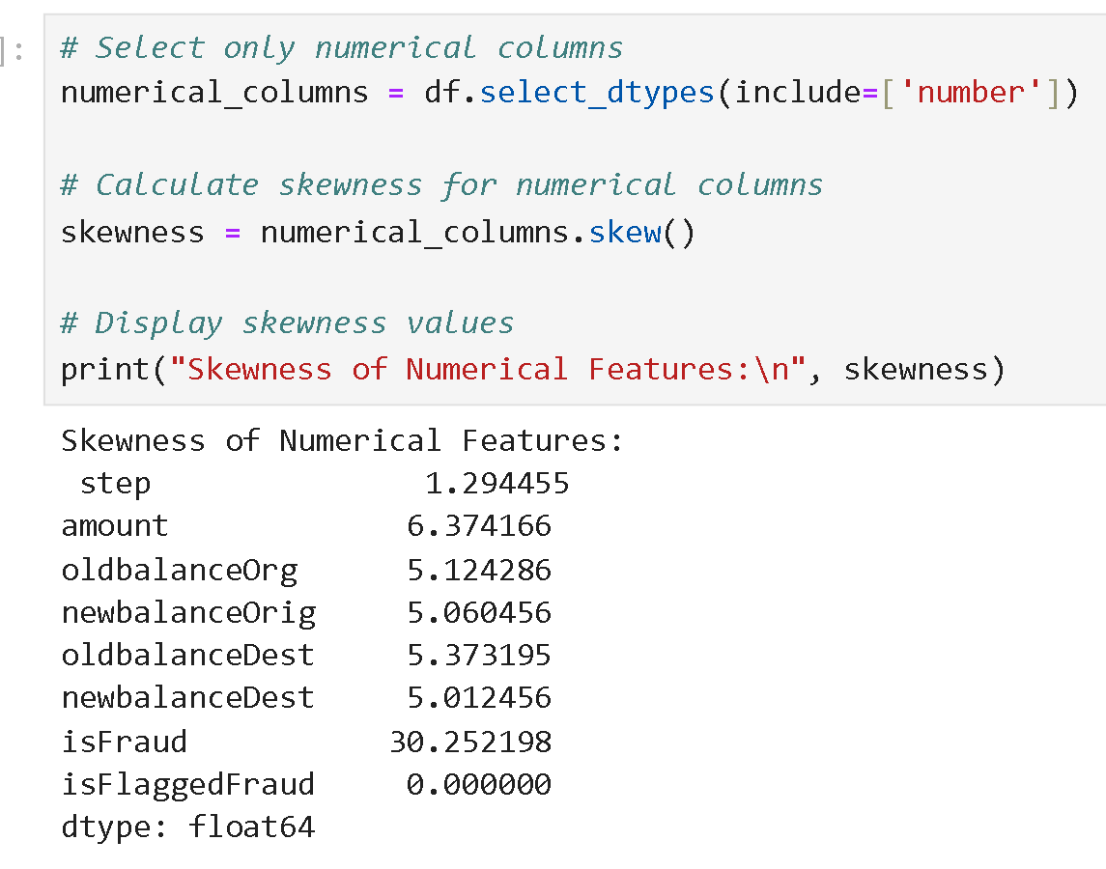
Skewness

Slide 21
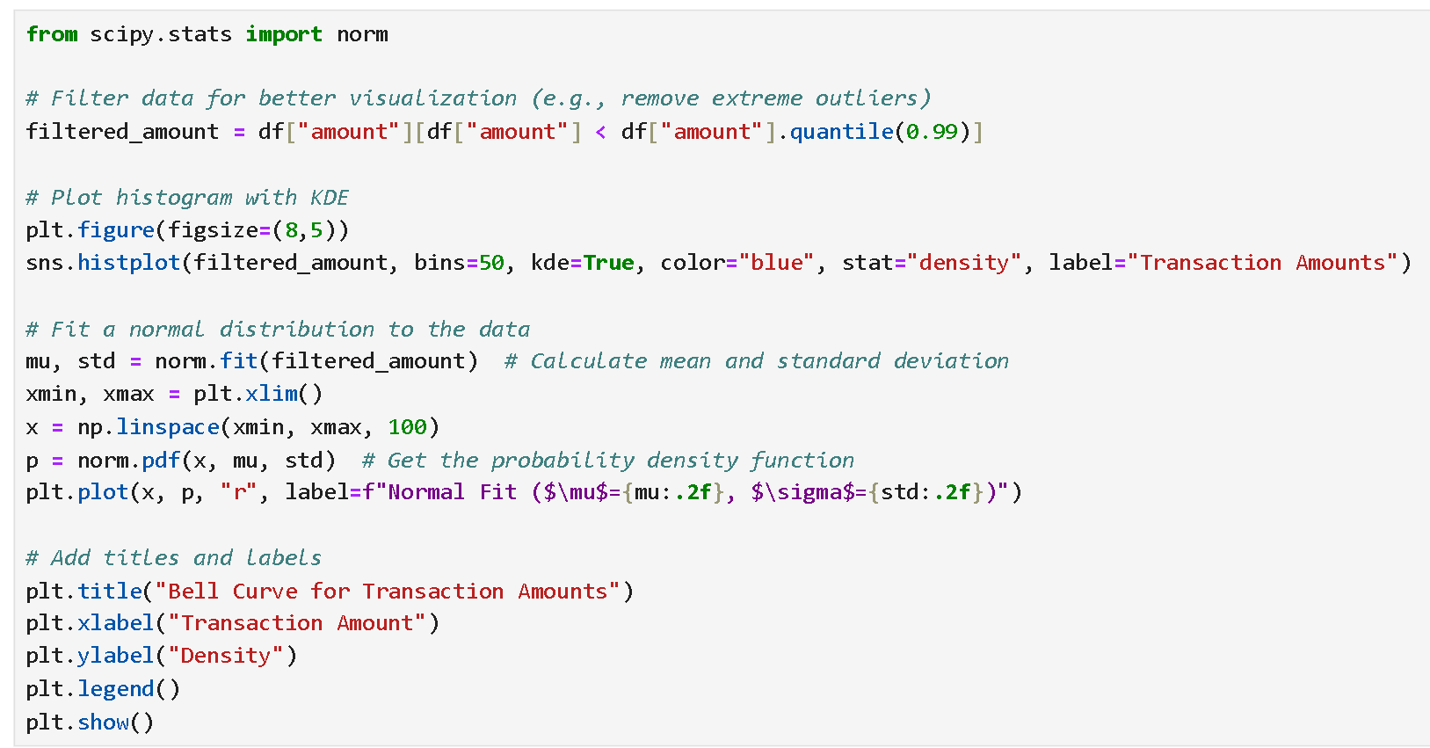
Bell Curve Histogram

Slide 22
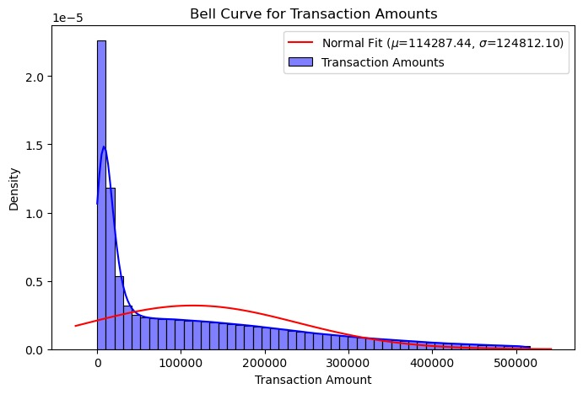
Bell Curve Histogram

Slide 23
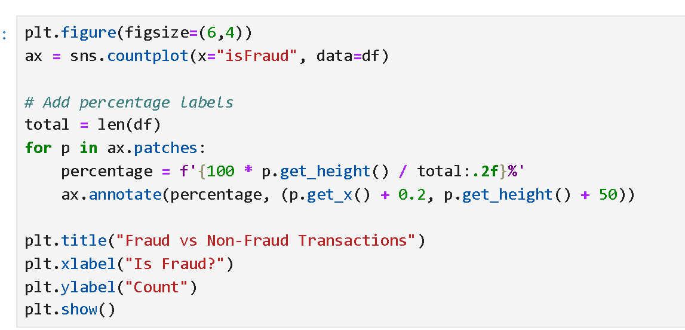
Countplot: Fraud VS Non Fraud Transaction

Slide 24
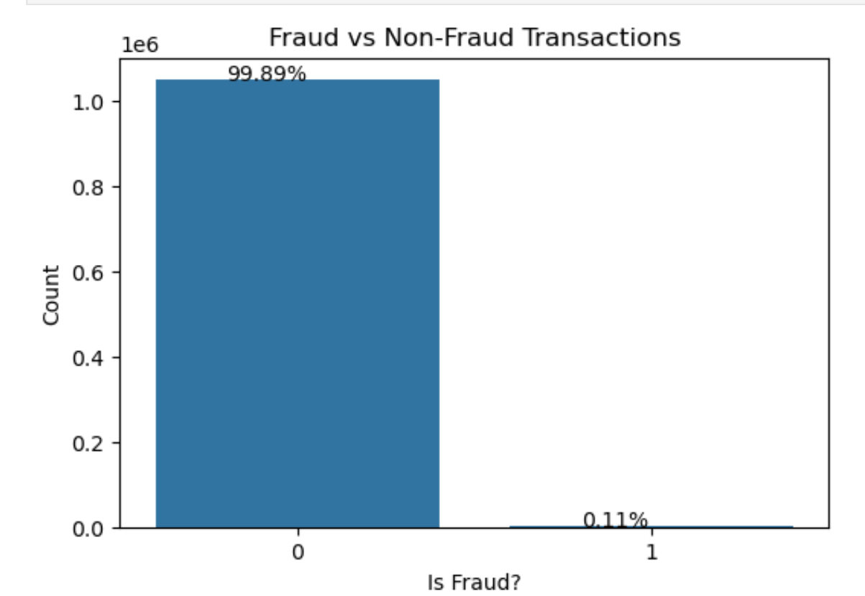
Countplot: Fraud VS Non Fraud Transaction

Slide 25
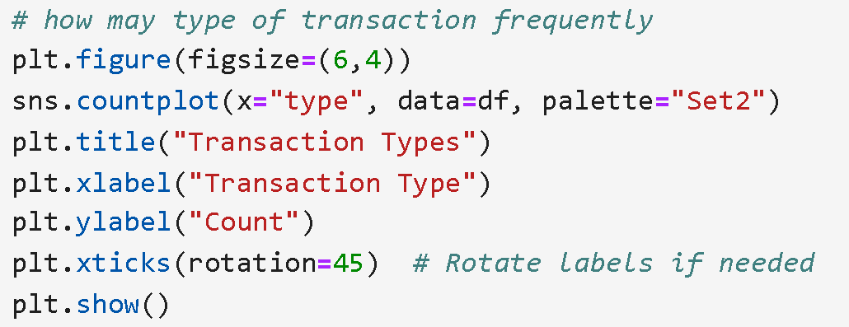
Countplot On Transaction Types

Slide 26
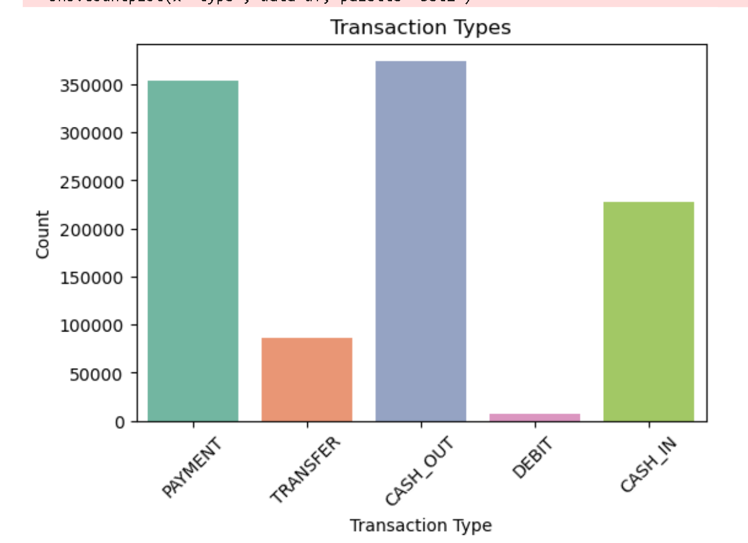
Countplot On Transaction Types

Slide 27
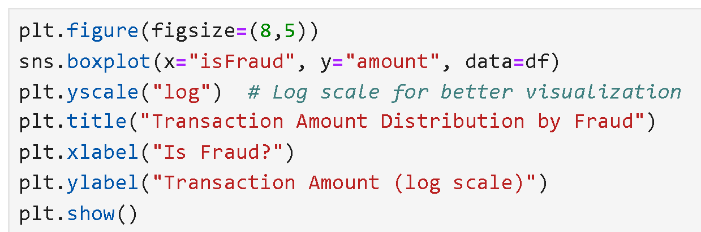
Boxplot On Fraud Column

Slide 28
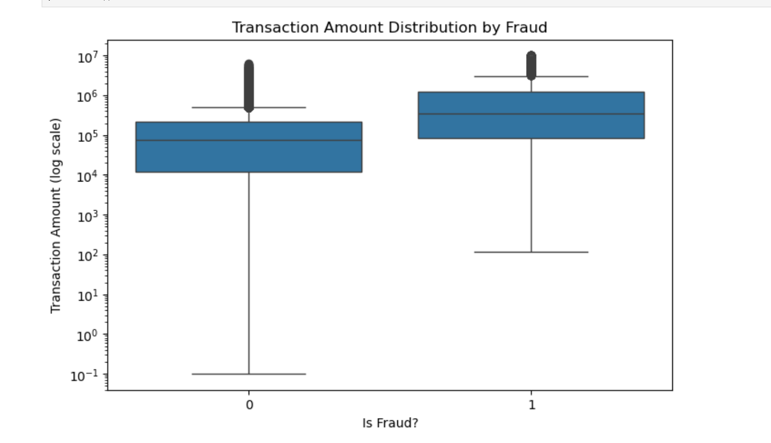
Boxplot On Fraud Column

Slide 29
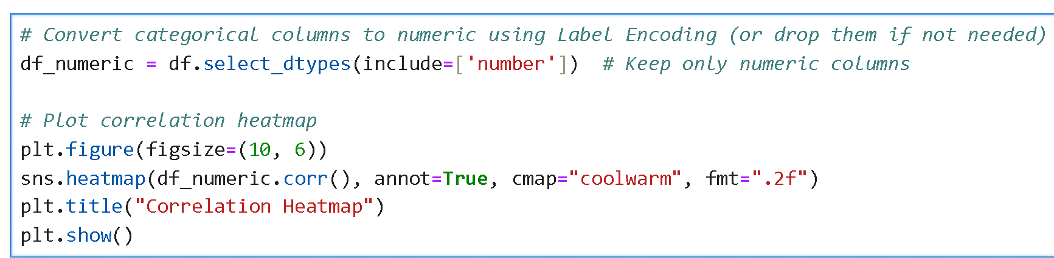
Heatmap On Numerical Values

Slide 30
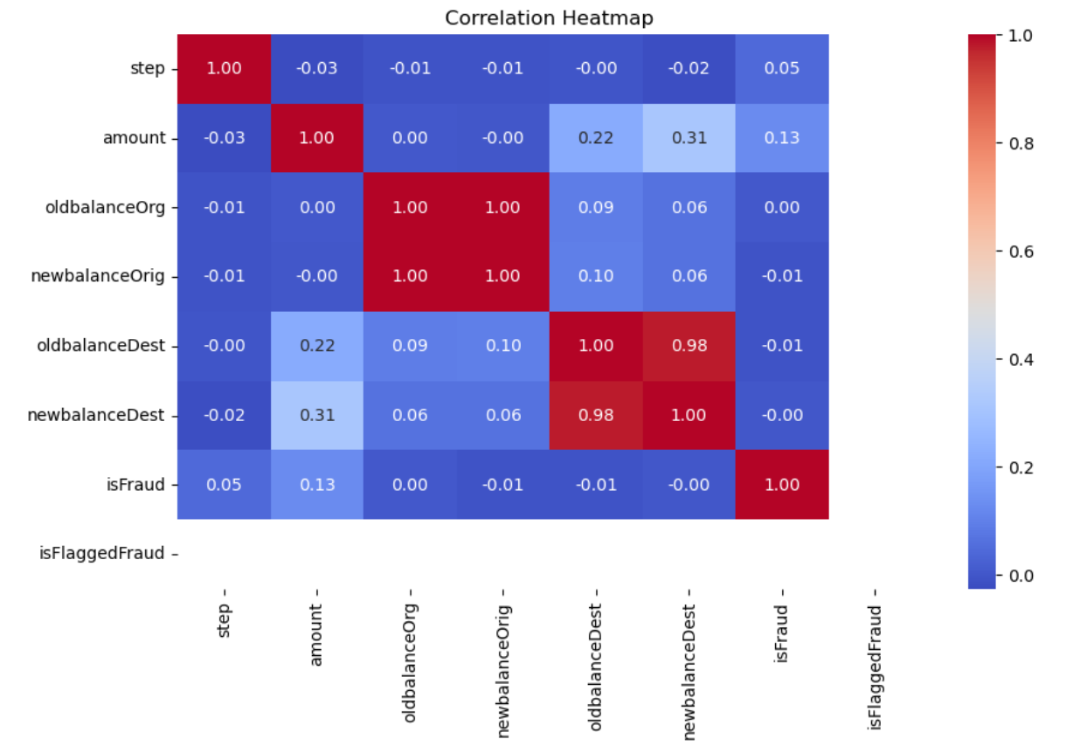
Heatmap On Numerical Values

Slide 31
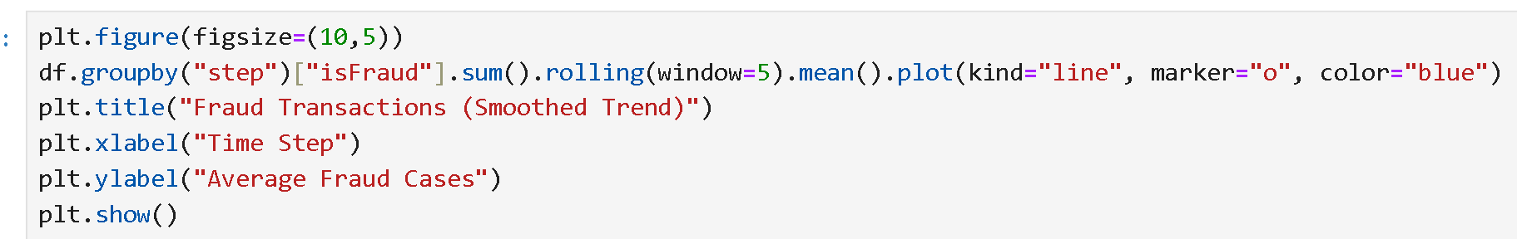
Line Chart: Show Fraud Transaction Time By Time

Slide 32
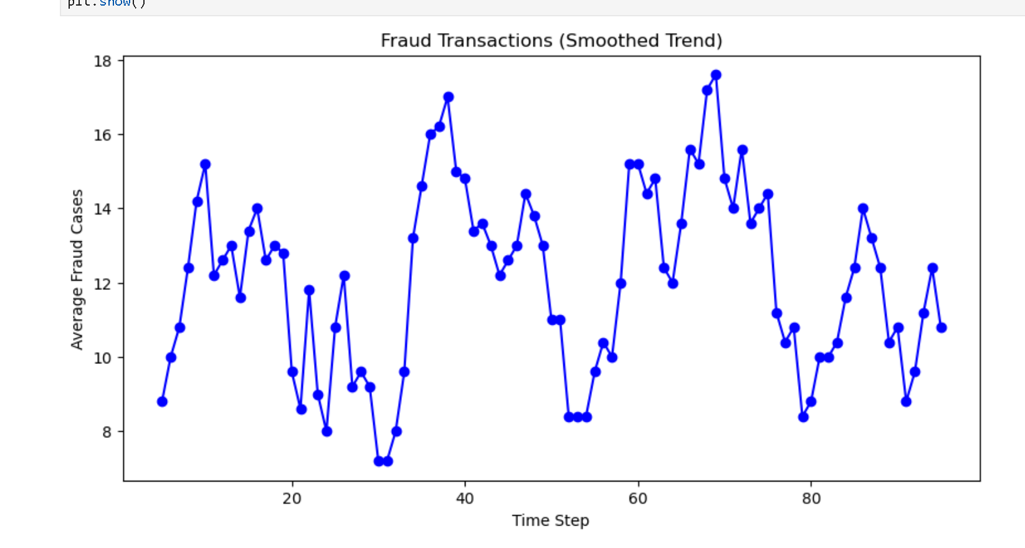
Line Chart: Show Fraud Transaction Over Time

Slide 33
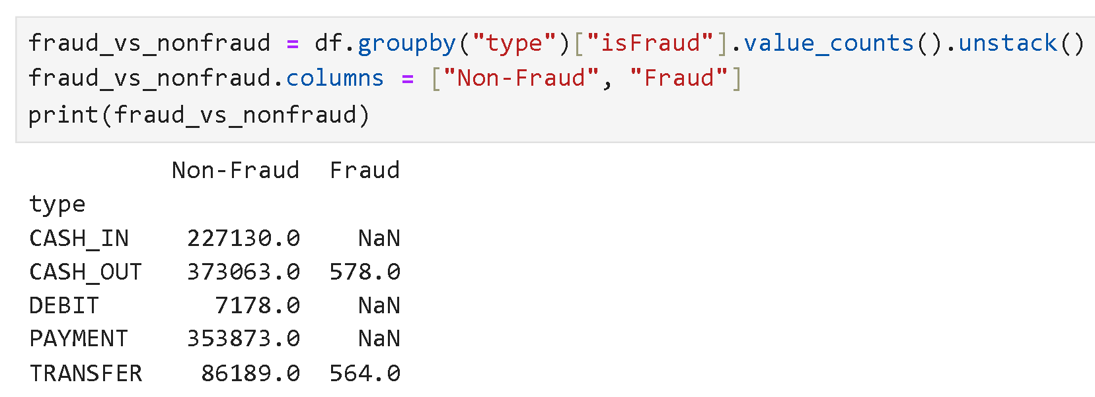
Fraud And Non-Fraud On Transaction Types

Slide 34
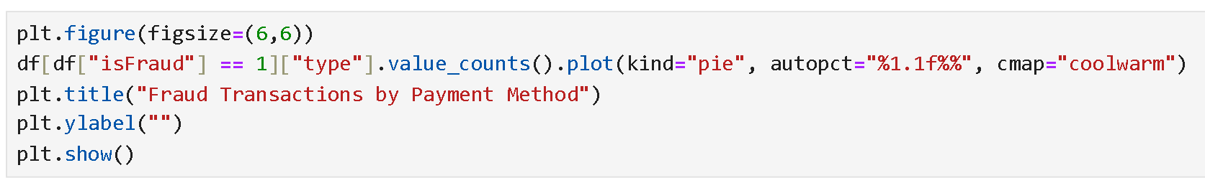
Pie Chart: Type Of Fraud Transaction

Slide 35
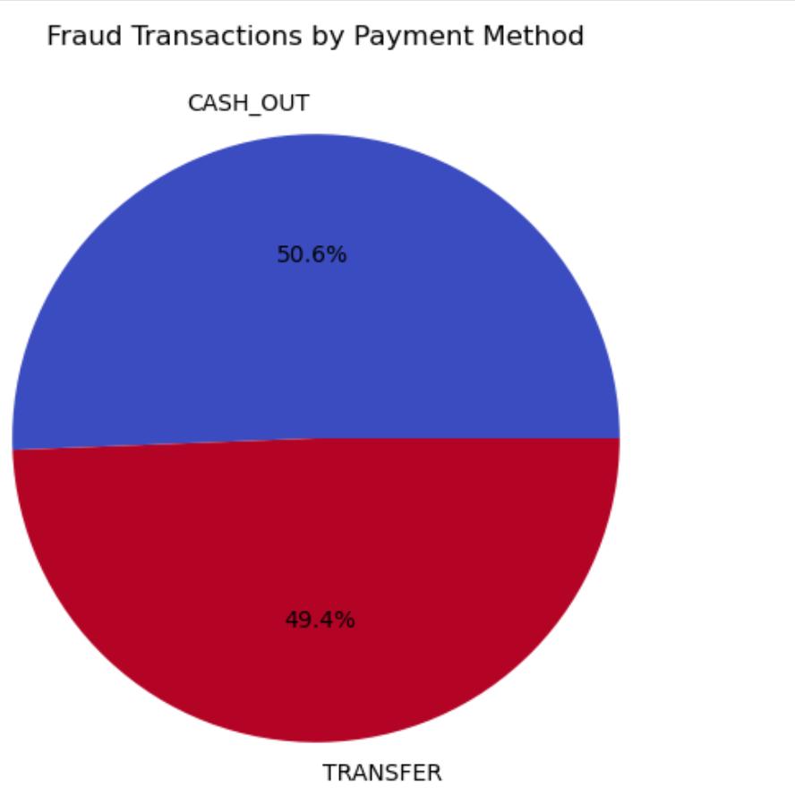
Pie Chart: Type Of Fraud Transaction

Slide 36
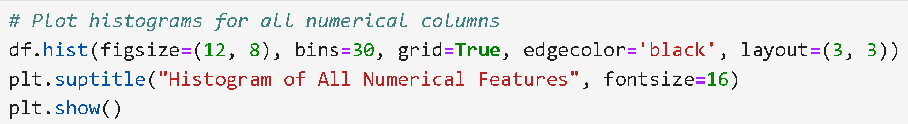
Histogram

Slide 37
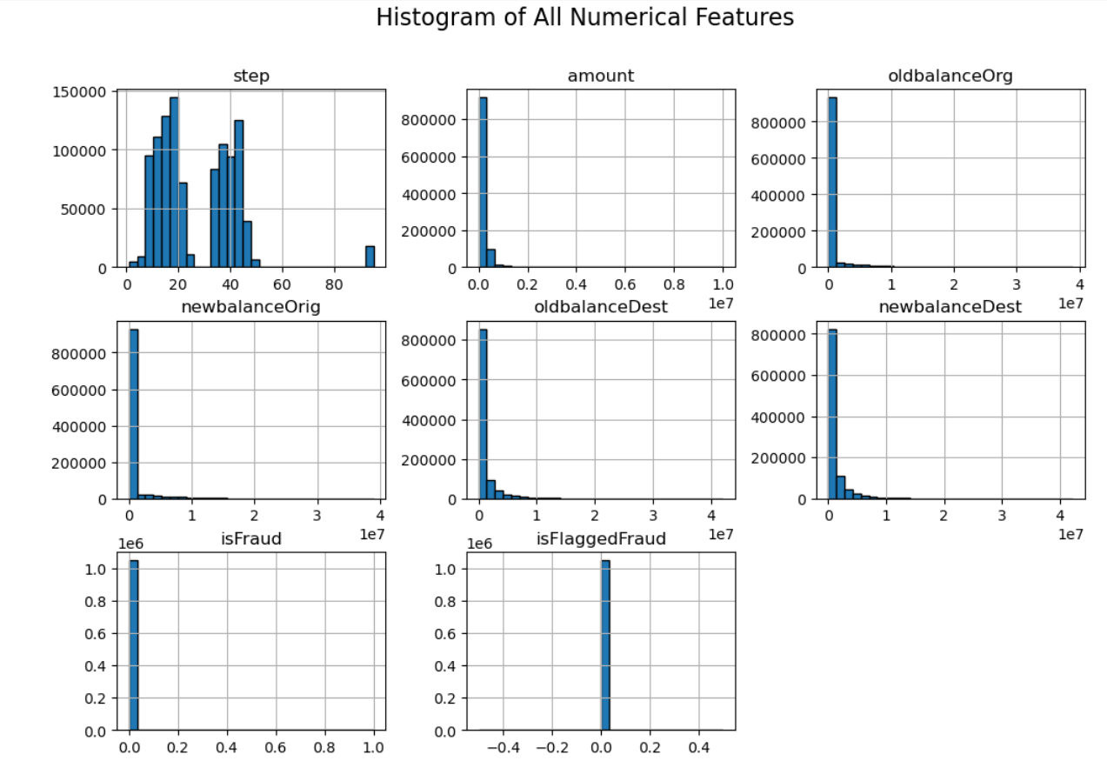

Slide 38
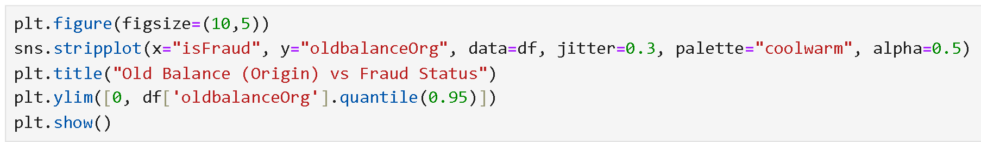
Strip Plot: Old Balance VS Fraud

Slide 39
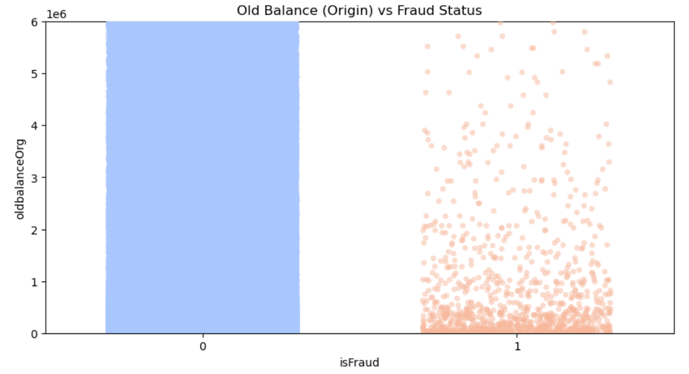
Strip Plot: Old Balance VS Fraud

Slide 40
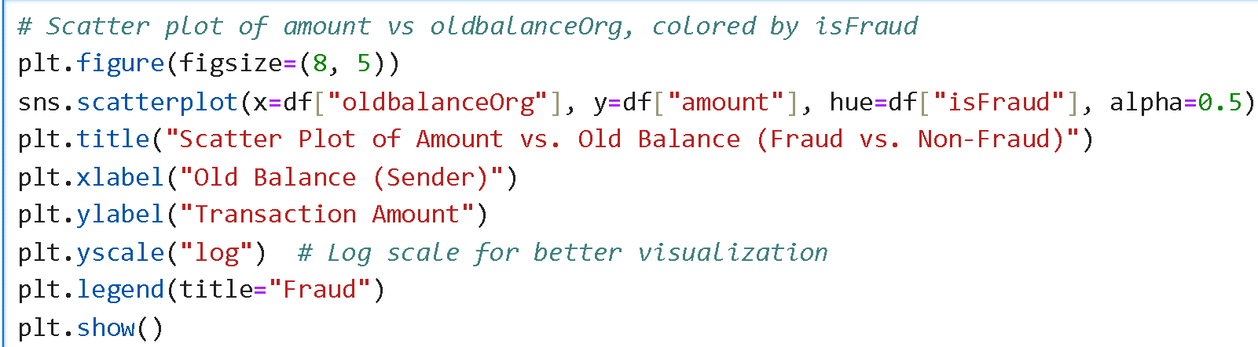
Scatter Plot: Fraud VS Non-Fraud

Slide 41
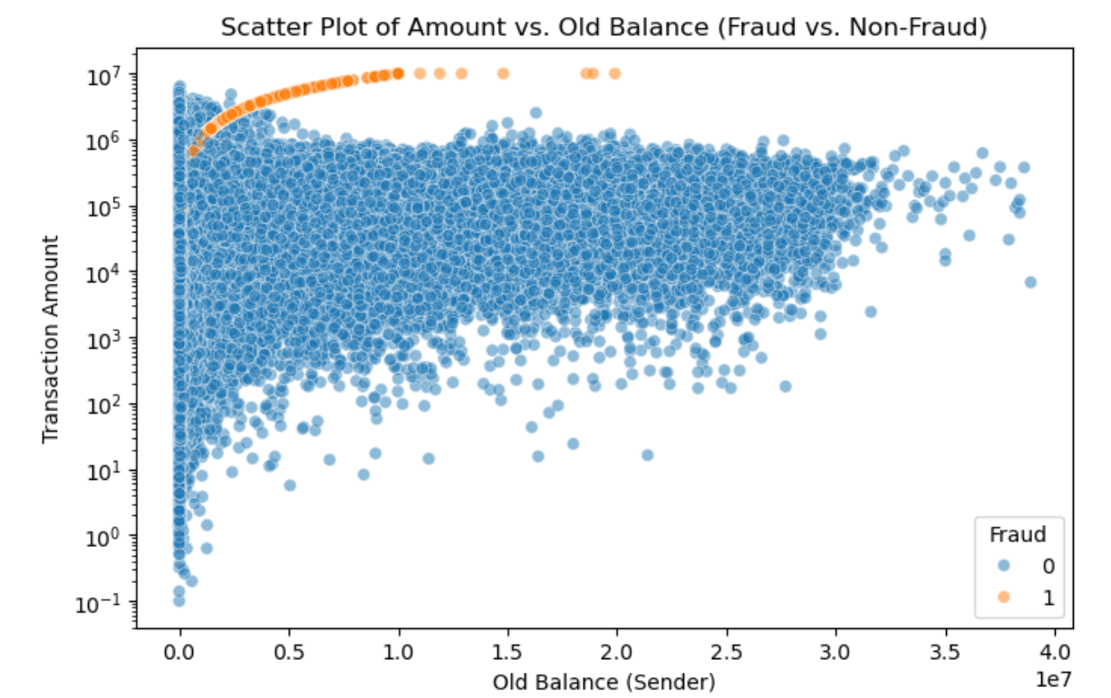
Scatter Plot: Fraud VS Non-Fraud

Slide 42
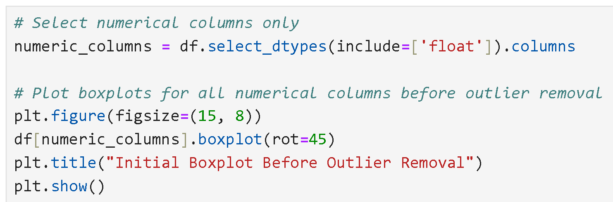
Boxplot: To Show Outliers

Slide 43
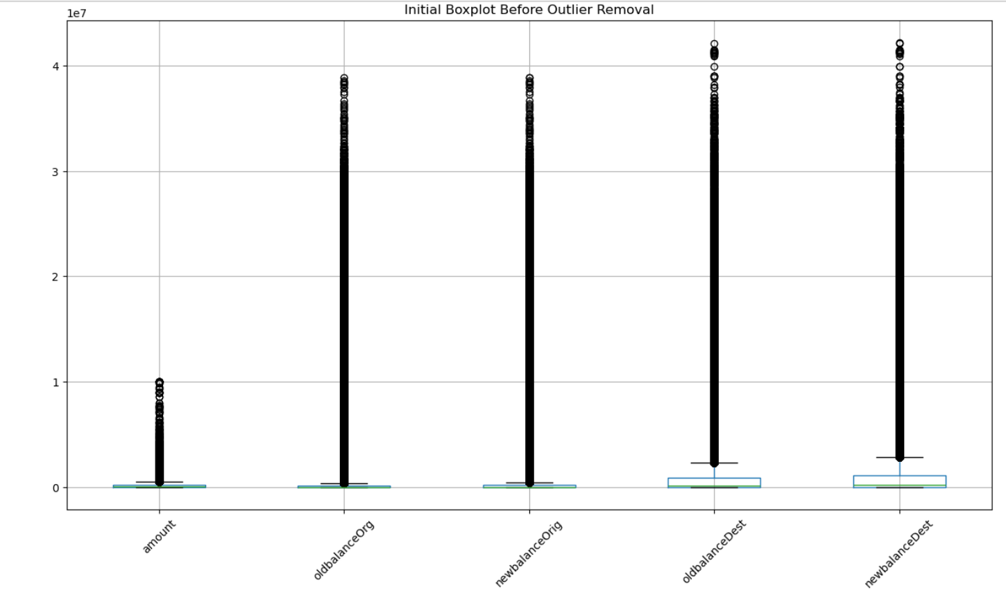

Slide 44
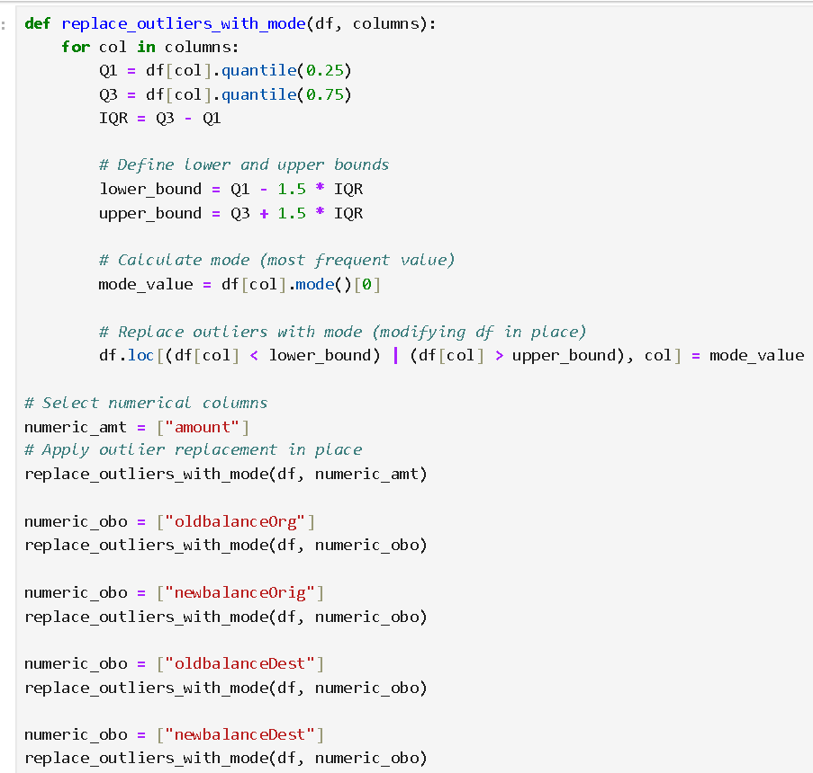

Slide 45
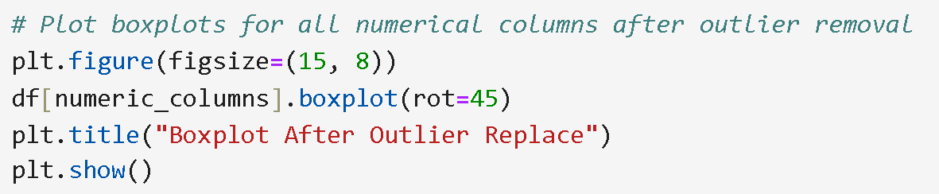
Boxplot: After Replace The Outliers

Slide 46
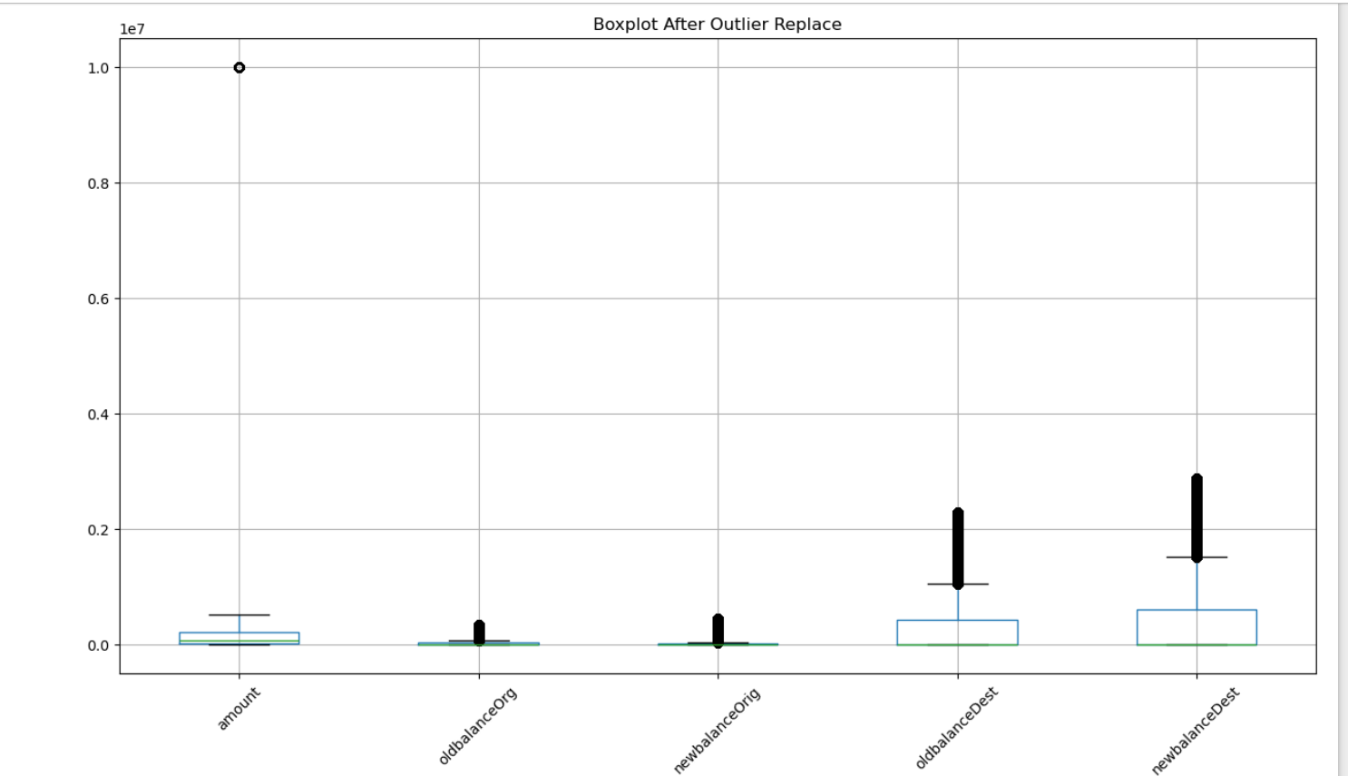
Boxplot: After Replace The Outliers

Slide 47
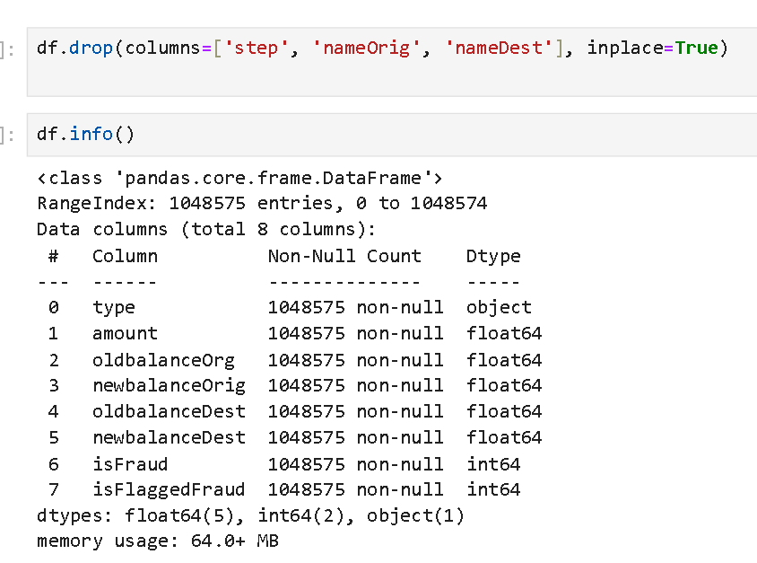
Drop The Unnecessary Columns

Slide 48
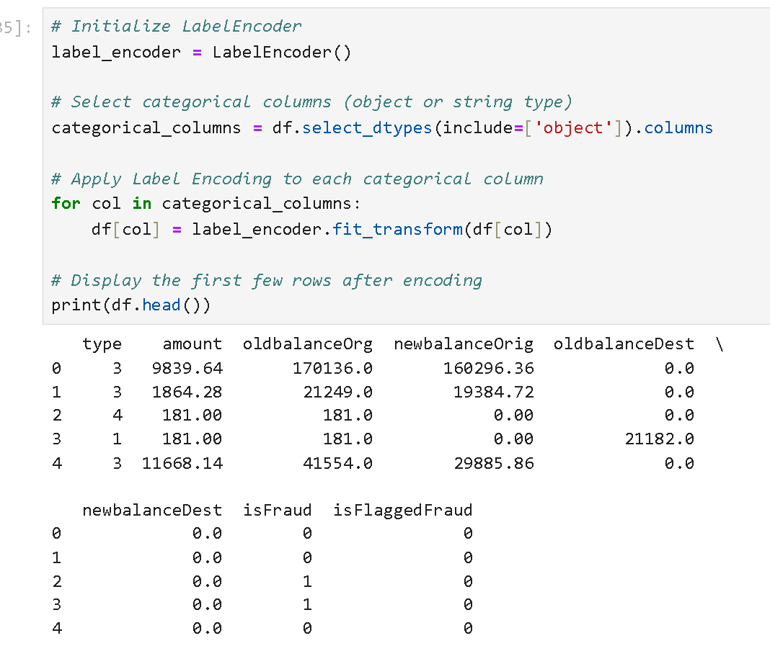
Label Encoding

Slide 49
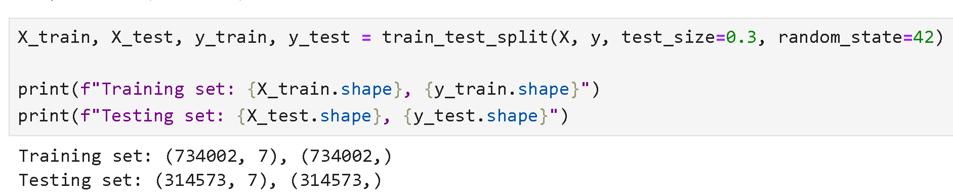
Split The Data Into Train And Test

Slide 50
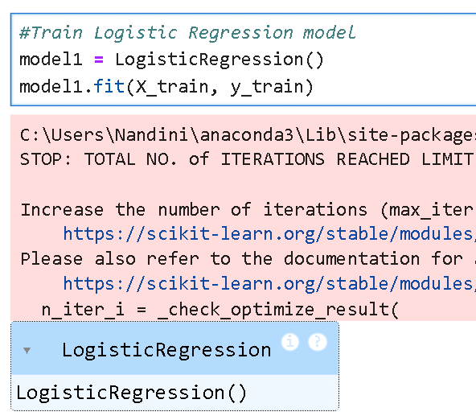
Train The Logistics Regression Model1

Slide 51
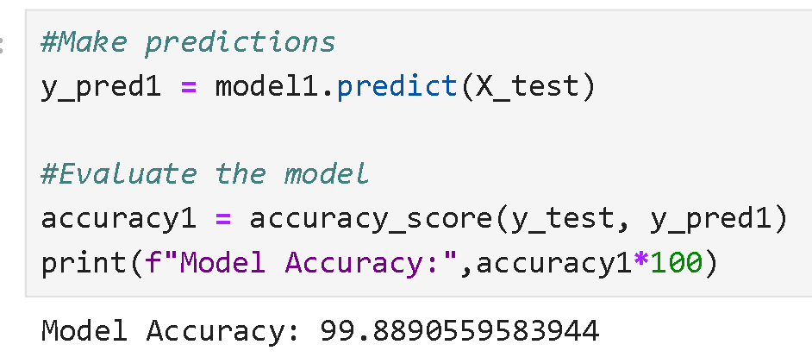
Predict And Accuracy Score On Logistics Model1

Slide 52
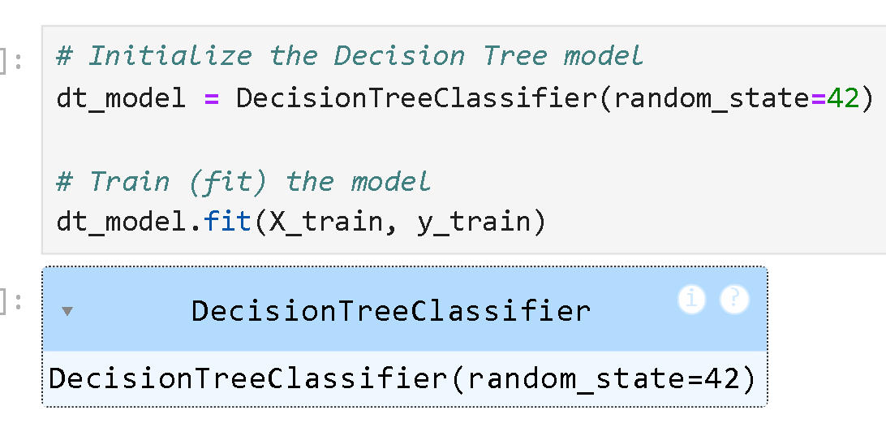
Train The Decision Tree Model2

Slide 53
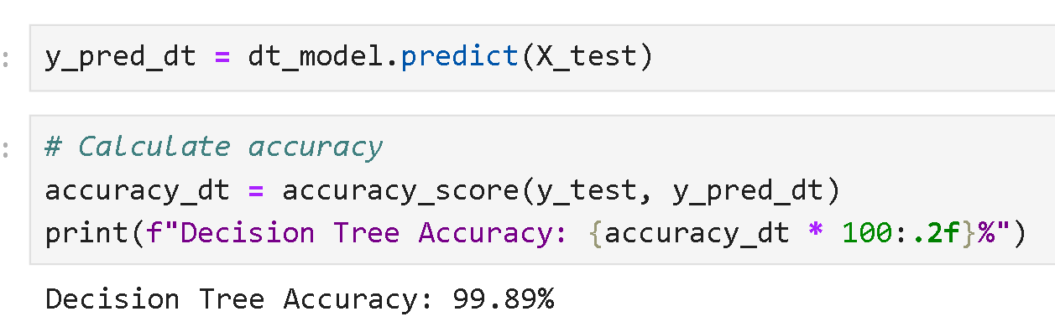
Predict And Accuracy Score On Decision- Tree Model2

Slide 54
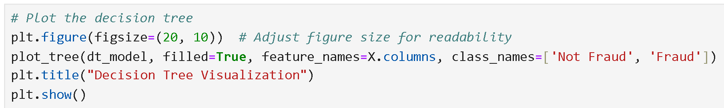
Show The Plot On Decision Tree

Slide 55
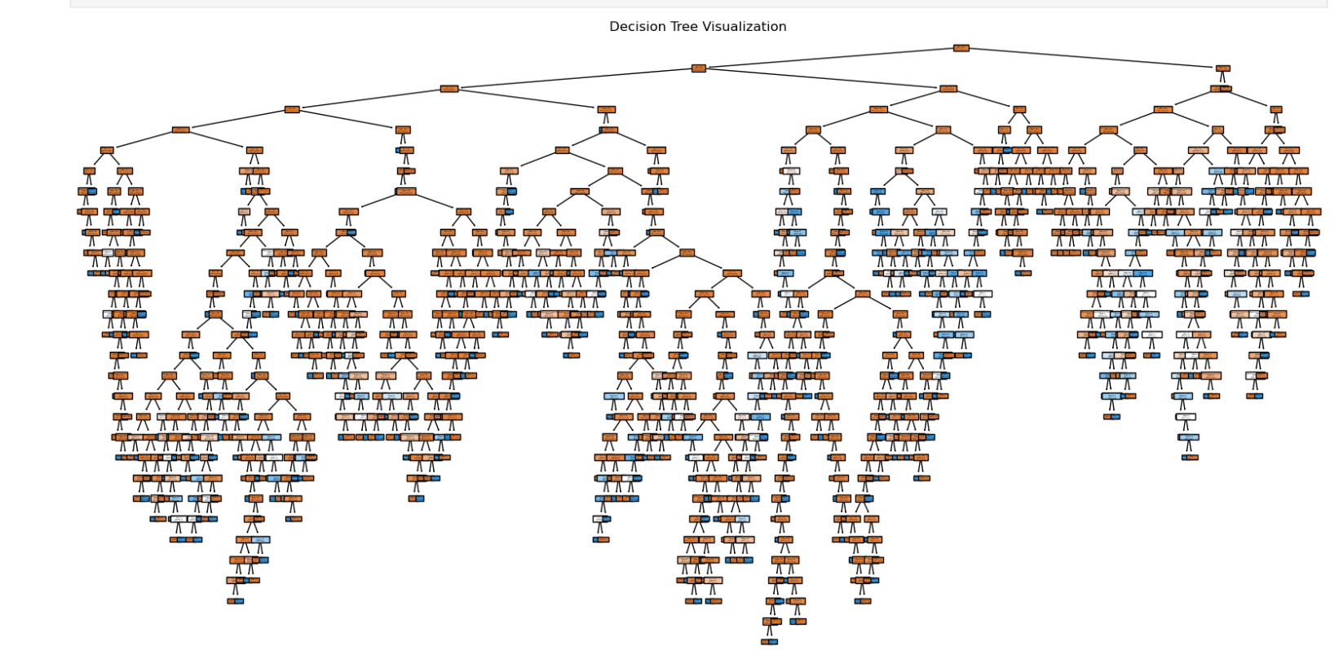
Decision Tree Visualization

Slide 56
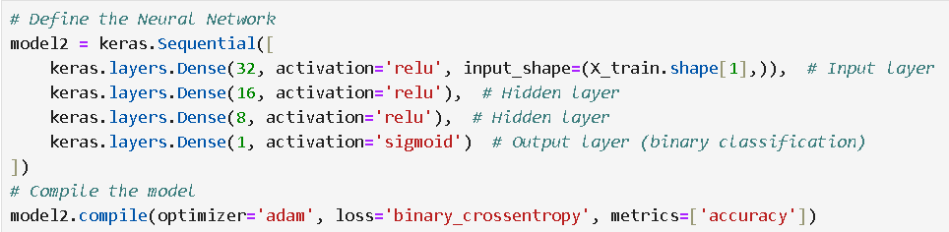
Define And Compile The Feedforward Neural Network Model3

Slide 57
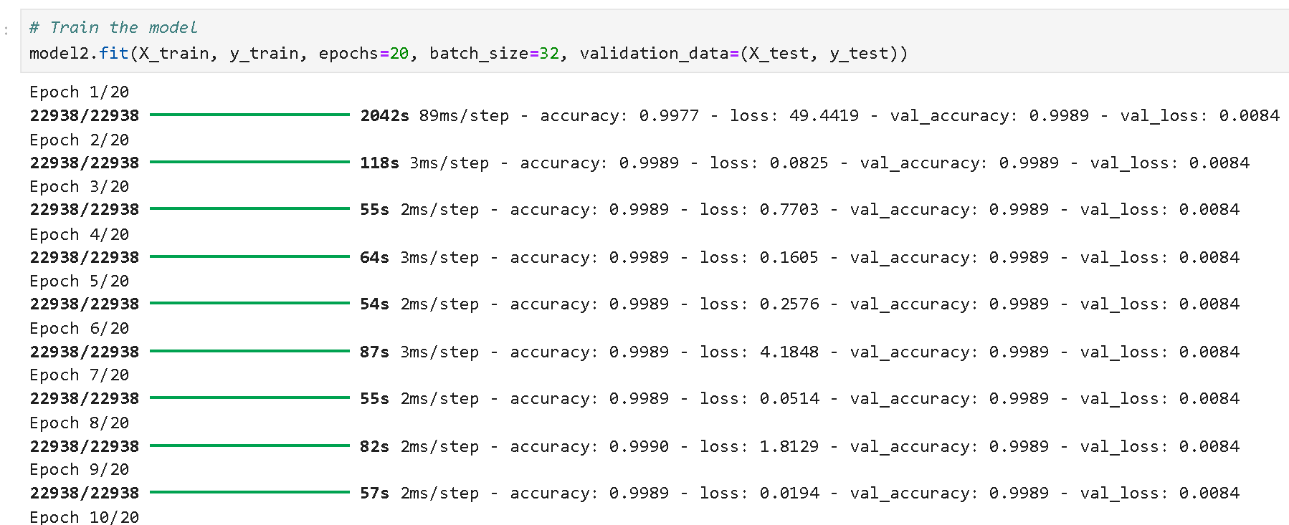
Train The Feedforward Neural Network Model3

Slide 58


Slide 59

Accuracy Score On Feedforward Neural Network Model3

Slide 60

Accuracy Score On eXtreme Gradient Boosting Model4

Slide 61
Thank You

